Slide 1

First Steps Analysis Document
MyThaiStar V1.0

Slide 2


Statement of Purpose
Project Introduction
MyThaiStar restaurant wants to improve his presence online, not only providing the menu, also offering the customers a full interactive experience with the new MyThaiStar application.
In the application the user will be able to:
- Browse the menu
- Reserve tables
- Order dishes online for their reservations
- Invite friends and automatically send invitation emails, containing links to order the dishes online.
- Rate the dishes of the restaurant via twitter.
It also allows the restaurant staff to monitor the reservations.
A successful solution would be to improve user experience facilitating reservations and ordering menus.

Slide 3
Objectives & Requirements
Requirements
Facilitate the process of making a reservation.
The objectives of the project are:
Reduce waiting time of the customers in the restaurant.
Improve user experience, having always available what they order.
The restaurant will know in advance which ingredients and quantities are demanded per day, doing easier the shopping and the stock management of products.
Track the more/less popular meals.
Communicate with clients with customized messages.
Facilitate the process of inviting friends.
Facilitate the process of ordering a meal.
Rate a dish on Twitter through the restaurant app.
Read twitter ratings of a dish.

Slide 4
Glossary of Terms
Booking
Reservation
A guest reserves a table in the restaurant and gets a Booking
Same as booking
Order
Menu
A guest orders some dishes and gets an Order
Same as order
Order Line
An ordered dish, including ordered extra ingredients

Slide 5
Actors
Reserving guest
A guest reserving a table using the MyThaiStar application.
Invitee
Guest
A guest that has been invited by a reserving guest.
Reserving guest + Invitee.
MyThaiStar
Waiter
The MyThaiStar application itself.
A waiter managing the tables and orders using the MyThaiStar application.

Slide 6


User Story Map (1/2)
USER STORIES
USER STORIES
USER STORIES
Access
Manage Booking
Manage invitations
EPICS
Display Home Screen
Select Action Book Table or Invite Friends
Accept invitation
Select date and time
Decline invitation
Create Booking
Revoke invitation
Invite friends
Cancel Booking

Slide 7
User Story Map (2/2)
USER STORIES
USER STORIES
USER STORIES
USER STORIES
Digital Menu
Profile
Calculate Best Table
Waiter Cockpit
EPICS
Filter Dish
Login
Assign table to Booking
Find Order
Select dish
Sing up
Delete Booking
See All
Delete dish
Link twitter account
Revoke invitation
Create Order
Auto login in twitter
Cancel Order
Rate Menu
Read twitter rating

Slide 8

Epic 1 Access
At this step, the user enters into the app.
MyThaiStar must support at this point:
Show the home screen
© 2017 Capgemini. All rights reserved.

Slide 9
User Story 1
Display Home Screen
I need
to enter into MyThaiStar app
So that
I can view the home screen
Acceptance Criteria:
There will be a header with a linked logo of MyThaiStar which leads to home screen, a Home link also leading to home screen, a Menu link leading to the Order Menu screen, a Book Table link leading to Create Booking screen. In the right corner there will be a User icon linked with the Login/Singup screen and even more in the right, a Shopping Basket icon linked with the Create Order screen.
In the center of the screen there will be to direct access with descriptive pictures to Book a Table and Menu, with same behavior as links in the header area.
The right marginal column contains the dishes and drinks of the current order. If there is no current order it will be empty. It should appear when a dish is selected from the Order Menu Screen and also when the linked Shopping Icon is selected. It should disappear when the user press again in the left part of the screen, the CANCEL button is pressed or the Order is completed.
The will be a footer with the name of the application and the creation year on the left side.
Reserving guest
Priority:High
Size:
Dependency:
© 2017 Capgemini. All rights reserved.

Slide 10
Epic 2 Manage Booking
It contains all functions that permit to book a table, invite friends and cancel a booking.
It must support at this point:
Create a booking.
Invite Friends.
Cancel a booking.
© 2017 Capgemini. All rights reserved.

Slide 11
User Story 2
Select Action Book Table
or Invite Friends
I want
to reserve a table inviting or not friends
So that
I chose the Book Table or Invite Friends link on the menu application bar or in the direct access area in the middle of the screen
Acceptance Criteria:
The Book Table link and the direct access should be on the Home page screen.
The Invite Friends link and the direct access should be on the Home page screen.
The system should change the screen after selection of the option and show the Book table or the Invite friends screen.
Reserving guest
Priority:High
Size:
Dependency: user story 1
© 2017 Capgemini. All rights reserved.

Slide 12
User Story 3
Select Date and Time
I want
to select date and time
So that
I could proceed with the reservation of the table
Acceptance Criteria:
This screen should be a modal screen that can be called from different places.
Calendar should display 1 month only.
The displayed month will be the current month from the current year.
The system permits selection of current or future date.
The system allows selection of 1 day only.
After selecting the date, the system should show a clock where a time should be selected.
After selecting the time, the window disappears.
Reserving guest
Priority:High
Size:
Dependency: user story 4,5
© 2017 Capgemini. All rights reserved.

Slide 13
User Story 4
Create Booking
I want
to create a booking with table reservation
So that
I get a reservation confirmation.
Acceptance Criteria:
The application should show the Book Table screen with a direct access to “Select Date and Time” screen and display the selection made by the user and 3 additional fields: Name, Email and Number of Assistants. All fields are mandatory.
On the bottom left side should be a check “Accept Terms”.
On the bottom right area there will be 1 button – BOOK TABLE.
Unless every field in the screen is filled up and the check “Accept Terms” selected the “BOOK TABLE” button will not be active.
The system will check if the email is well formed.
If booking succeeds, the system will display a confirmation screen of the reservation with datetime, number of persons.
The system will send a confirmation email with all reservation data.
Reserving guest
Priority:High
Size:
Dependency: user story 1
© 2017 Capgemini. All rights reserved.

Slide 14
User Story 5
Invite Friends
I want
to create a booking with table reservation and invite friends
So that
I get a reservation confirmation and the invitations are sent
Acceptance Criteria:
The Invite friends screen is a tab of the Book table screen.
The application should show the Book Table screen and as a user I should select the Invite friends tab.
The Invite friends screen should contain a direct access to “Select Date and Time” screen and display the selection made by the user and 3 additional fields: Name, Email and Guests. Guest is a list of valid emails. All fields are mandatory.
On the bottom left side should be a check “Accept Terms”.
On the bottom right area there will be 1 button – INVITE FRIENDS.
Unless every field in the screen is filled up and the check “Accept Terms” selected the “INVITE FRIENDS” button will not be active.
The system will check if the email is well formed.
If booking succeed the system will display a confirmation screen of the reservation with datetime, number of persons.
The system will send a confirmation email with all reservation data to the creator of the booking.
The system will send an invitation to every email in the guest list.
Reserving guest
Priority:High
Size:
Dependency: user story 1
© 2017 Capgemini. All rights reserved.

Slide 15
User Story 6
Cancel Bookings
I want
cancel a booking previously made by me, with or without friends
So that
I get a cancel confirmation and the invitations cancellation are sent
Acceptance Criteria:
I should have the booking confirmation email with a cancellation link.
After my cancellation all the invited guest (if there is any) receives an email about the cancellation.
The system sends a confirmation email with the message. The booking has been successfully canceled.
All the related invitations and orders to the booking are deleted from the system.
The cancellation is only possible until one hour before the booking reservation date time.
Reserving guest
Priority:High
Size:
Dependency: user story 4,5
© 2017 Capgemini. All rights reserved.

Slide 16
Epic 3 Manage invitations
It contains all functions to handle the invitations sent by the system.
© 2017 Capgemini. All rights reserved.

Slide 17
User Story 7
Accept Invitation
I want
to accept an invitation
So that
I confirm my attendance
Acceptance Criteria:
I should have the booking confirmation email with an invitation and an acceptance link.
After my acceptance, the system should store my acceptance of the invitation.
The system sends a confirmation email with the invitation ID and a revocation link.
Invitee
Priority:Medium
Size:
Dependency: user story 5
© 2017 Capgemini. All rights reserved.

Slide 18
User Story 8
Decline Invitation
I want
to decline an invitation
So that
I confirm my absence
Acceptance Criteria:
I should have the booking confirmation email with an invitation and a decline link.
After my declination, the system should store my declination of the invitation.
The system sends an email with my declination to me and the other invitees and to the booking’s creator.
Invitee
Priority:Medium
Size:
Dependency: user story 5
© 2017 Capgemini. All rights reserved.

Slide 19
User Story 9
Revoke Invitation
I want
to revoke a confirmed invitation
So that
I decline the accepted invitation
Acceptance Criteria:
I should have the invitation ID confirmation email with a revoke link.
The revoke is only possible until 10 minutes before the order date time. In case the cancellation is not possible an error message is displayed: Cancellation is not possible.
Upon successful revocation, the system should store my declination of the invitation.
If a menu order was created with my invitation Id, the order is deleted.
The system sends an email with my declination to me and the other invitees and to the booking’s creator.
Invitee
Priority:Medium
Size:
Dependency: user story 5
© 2017 Capgemini. All rights reserved.

Slide 20
Epic 4 Digital Menu
It contains all functions to create and manage a menu order.
© 2017 Capgemini. All rights reserved.

Slide 21
User Story 10
Filter Dish
I want
to filter the menu
So that
I only see the dishes I am interested in
Acceptance Criteria:
The guest can filter by:
Type: starter | main dish | dessert; (all default value)
Veggy (yes|no|does not matter (default))
Vegan (yes|no|does not matter (default))
Rice (yes|no|does not matter (default))
Curry (yes|no|does not matter (default))
Noodle (yes|no|does not matter (default))
Price (range)
Ratings (range)
Favorites (yes|no|does not matter (default))
Free text (search in title and description)
The guest can sort by price and rating.
After setting the filter only dishes are shown which fulfills those criteria.
By pressing the button reset filter all filters are reset to the initial value
By pressing the filter button, the filters are applied.
Guest
Priority:Low
Size:
Dependency: user story 4,5
© 2017 Capgemini. All rights reserved.

Slide 22
User Story 11
Select Dish
I want
to define my order by selecting dishes from the menu
So that
I see the dishes
Acceptance Criteria:
The guest can add each dish to the order.
In case the guest adds the same dish multiple times, a counter in the order for this dish is increased for this dish.
The guest can add for each main dish the type of meat (pork, chicken, tofu).
The guest can add for each dish a free-text-comment.
After adding any dish, the price is calculated including VAT
Guest
Priority:Medium
Size:
Dependency: user story 4,5
© 2017 Capgemini. All rights reserved.

Slide 23
User Story 12
Delete Dish
I want
to define my order by removing dishes from my ongoing order
So that
I only see the dishes I have already selected
Acceptance Criteria:
The guest can remove the dish from the order.
In case the counter in the order for this dish bigger than 1, decrease in 1.
After removing any dish, the price is calculated including VAT.
Guest
Priority:Medium
Size:
Dependency: user story 4,5
© 2017 Capgemini. All rights reserved.

Slide 24
User Story 13
Create Order
I want
to order my selected dishes (order)
So that
I see the dishes I have already selected
Acceptance Criteria:
Each order must be associated with a reservation / invite. Without any reference no order could be placed. The reference could be obtained from a previous reservation/invite (created during same session) or by the previous accepted invite (link in email) or by entering the reference id when asked by the system. In case precondition is not fulfilled, the guest is asked:
Whether he/she would like to create a reservation/invite and is forwarded to US Invite Friends. Only after finalizing the reservation the order is accepted.
Or he/she would enter previous created reservation-id he/she knows to associate the order with this reservation.
I receive a mail containing my order with all dishes and the final price.
Guest
Priority:Medium
Size:
Dependency: user story 4,5
© 2017 Capgemini. All rights reserved.

Slide 25
User Story 14
Cancel Order
I want
to cancel my order
So that
I get an email with the order confirmation
Acceptance Criteria:
In my received confirmation mail I have the option to cancel my order.
The cancellation is only possible until one hour before my reservation takes place.
My order is deleted from the system.
I receive a mail confirming my cancellation.
Guest
Priority:Medium
Size:
Dependency: user story 13
© 2017 Capgemini. All rights reserved.

Slide 26
User Story 15
Read twitter rating
I want
to read for all dishes the rating done be twitter because I would like to know the opinion of others
So that
I select a dish
Acceptance Criteria:
For each dish I see the latest 3 comments done by twitter for this vote (text, username, avatar).
For each dish I see the number of likes done by twitter.
Guest
Priority:Low
Size:
Dependency: user story 11
© 2017 Capgemini. All rights reserved.

Slide 27
Epic 5 Profile
It contains all functions to create and manage a user profile.
© 2017 Capgemini. All rights reserved.

Slide 28
User Story 16
Login
I want
to sign in with my MyThaiStar user name and password
So that
I’m allowed to modify my profile
Acceptance Criteria:
The Login Screen is a modal screen.
The application should show the Log in screen with 2 fields: Username and Password.
On the bottom right area there will be 2 buttons – Cancel and Login.
The user must provide a valid username and password.
The system will check if the user exists in the system.
The screen will disappear when Cancel or Login are pressed.
In case the user doesn’t exists, an error message should be shown - User does not exist.
If login succeed the system will display a banner message informing the user.
Guest
Priority:Low
Size:
Dependency: user story 1
© 2017 Capgemini. All rights reserved.

Slide 29
User Story 17
Sign Up
I want
to register myself as a user of MyThaiStar application
So that
I see the login screen
Acceptance Criteria:
The Sing up Screen is a modal screen. It’s a tab of the Login modal screen.
The application should show the Sing up screen with 3 fields: Email, Password and Confirm Password. All fields are mandatory.
On the bottom left side should be a check “Accept Terms”.
On the bottom right area there will be 2 buttons – Cancel and Register.
Unless every field in the screen is filled up and the check “Accept Terms” selected the “Register” button will not be active.
The system will check if the email is well formed and not in use.
In case the email already exists, an error message should be shown – Email address already in use.
If register succeeds, the system will display a banner message informing the user.
Guest
Priority:Low
Size:
Dependency: user story 1
© 2017 Capgemini. All rights reserved.

Slide 30
User Story 18
Link Twitter Account
I want
to link my user of MyThaiStar application with my twitter account
So that
I can rate the dishes from the application
Acceptance Criteria:
A valid twitter user and password are stored in the user profile.
There´s a button to link my Twitter account on the sign up screen.
Guest
Priority:Low
Size:
Dependency: user story 16
© 2017 Capgemini. All rights reserved.

Slide 31
User Story 19
Auto login in twitter
I want
to use my twitter account for rating dishes without having to log in manually
So that
It is transparent to me
Acceptance Criteria:
A valid twitter user and password are stored in my profile.
If login fails, an error message is displayed.
Guest
Priority:Low
Size:
Dependency: user story 16
© 2017 Capgemini. All rights reserved.

Slide 32
User Story 20
Rate Menu
I want
to add a comment or a like via my twitter account for a dish
So that
I get an email to rate my dish
Acceptance Criteria:
The user must receive a mail by the system to rate my dish.
The user must have a twitter account.
Before I write my rate, I would like to be able to read all tweets of other users for this dish.
I would like to see the number of likes for a dish.
Guest
Priority:Low
Size:
Dependency: user story 19
© 2017 Capgemini. All rights reserved.

Slide 33
Epic 6 Calculate best table
It contains all functions the system must implement to calculate best table for a booking.
© 2017 Capgemini. All rights reserved.

Slide 34
User Story 21
Assign table to booking
I want
to check available tables one hour before the time of the booking
So that
I assign the booking the best table for that booking
Acceptance Criteria:
The system must find a table for a given date and time where seats of guests >= Count of invited guests plus one. In case of no results, decline booking and send error message to the booking owner. In case of any result, make a reservation for table.
For each decline of a guest done after the assignation, remove guest and search with reduced number for new table. In case table is found, reserve it and remove reservation from previous table. In case not, do not change the reservation.
MyThaiStar
Priority:Low
Size:
Dependency: user story 4,5
© 2017 Capgemini. All rights reserved.

Slide 35
User Story 22
Delete Booking
I want
to delete the bookings that have been declined
So that
I release all the resources (e.g. table, food) that were locked for that booking
Acceptance Criteria:
If a booking is declined the system must delete the booking and all the associated orders.
An email to every guest involved must be sent.
MyThaiStar
Priority:Low
Size:
Dependency: user story 4,5,21
© 2017 Capgemini. All rights reserved.

Slide 36
Epic 7 Waiter Cockpit
It contains all functions a waiter can do with a reservation and/or an order.
© 2017 Capgemini. All rights reserved.

Slide 37
User Story 23
Find Order
I want
to find an order or booking and the associated table
So that
I can plan the resources required to attend those guests
Acceptance Criteria:
The waiter can look for a booking or look for an order and get the associated table.
Waiter
Priority:Medium
Size:
Dependency: user story 4,5,21
© 2017 Capgemini. All rights reserved.

Slide 38
User Story 24
See All
I want
to have an overview of all the orders and bookings
So that
I can organize the restaurant duties
Acceptance Criteria:
All orders/reservations are shown in a list view (read-only). Those list can be filtered and sorted (similar to excel-data-filters).
Orders/reservations are shown in separate lists.
For each order the dish, meat, comment, item, reservation-id, reservation datetime, creation-datetime is shown.
For each reservation the inviter's email, the guests-emails, the number of accepts and declines, calculated table number, the reservation-id, reservation date-time and creation-datetime are shown.
The default filter for all lists is the todays date for reservation datetime. this filter can be deleted.
Only reservations and orders with reservation date in the future shall be available in this view. All other orders and reservation shall not be deleted; for data analytics those orders and reservation shall still exist in the system.
Waiter
Priority:Medium
Size:
Dependency: user story 4,5,21
© 2017 Capgemini. All rights reserved.

Slide 39
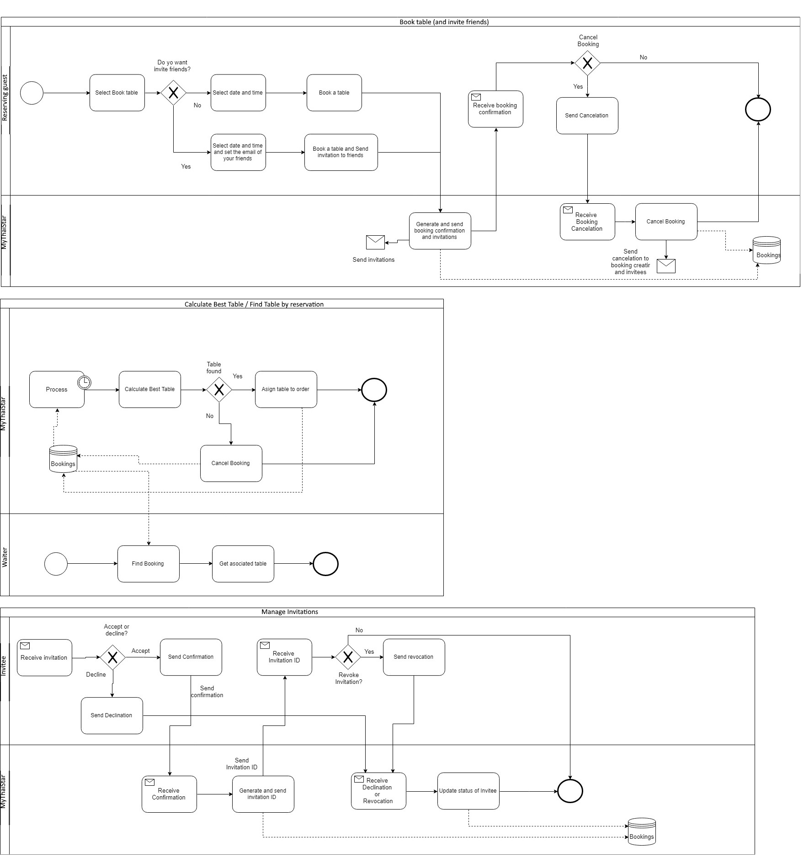
Business Process Map

Slide 40
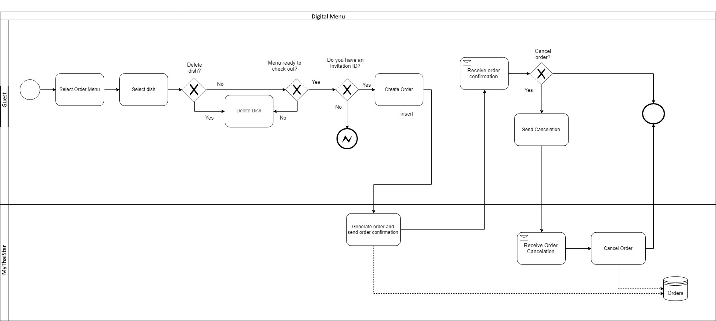
Business Process Map

Slide 41
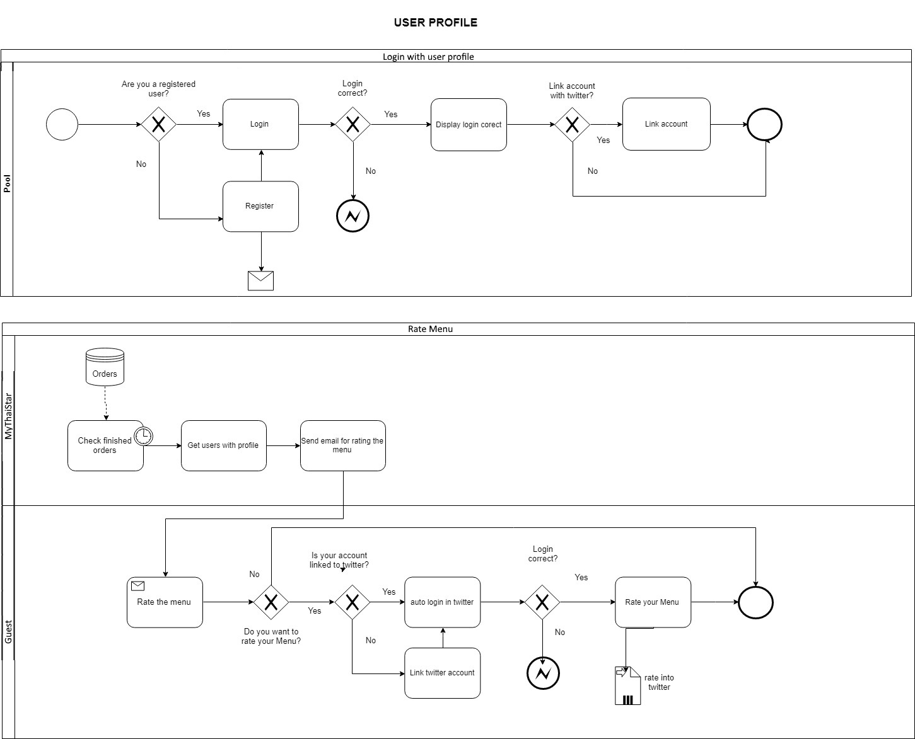
Business Process Map

Slide 42
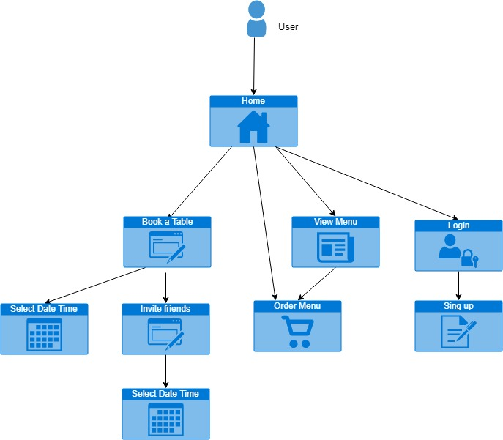
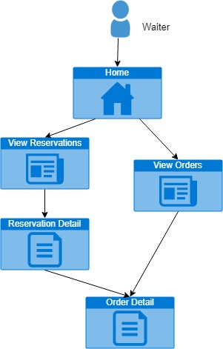
Sitemap
Screens & Initial structure

Slide 43
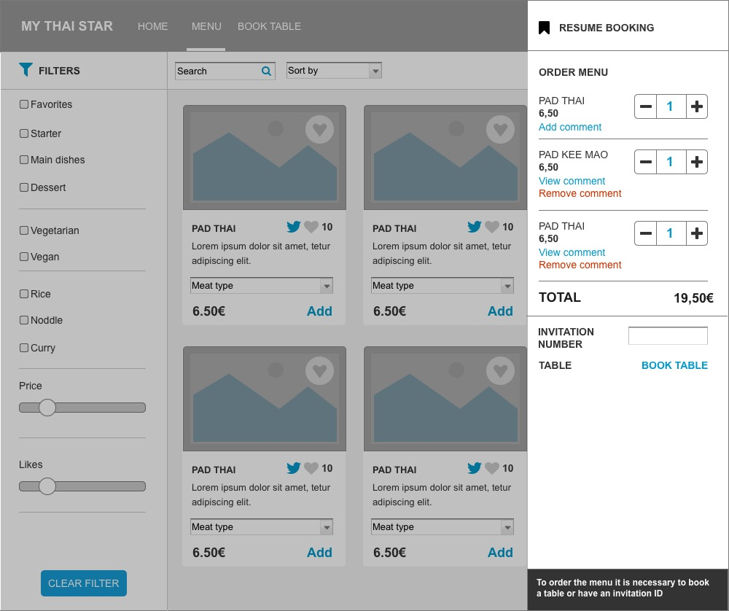
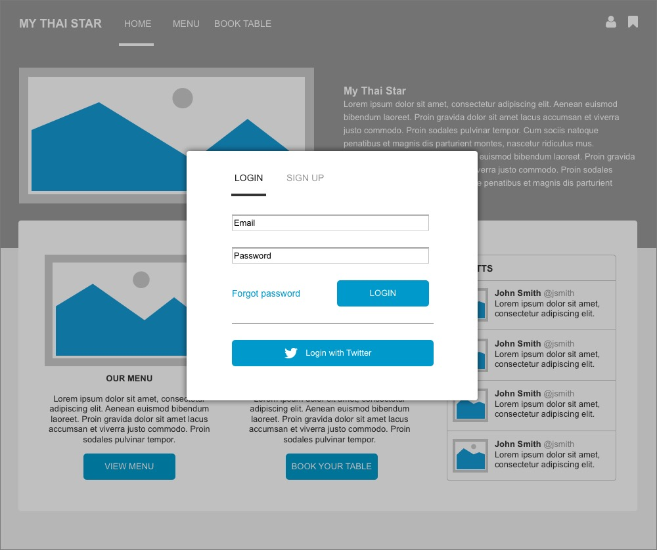
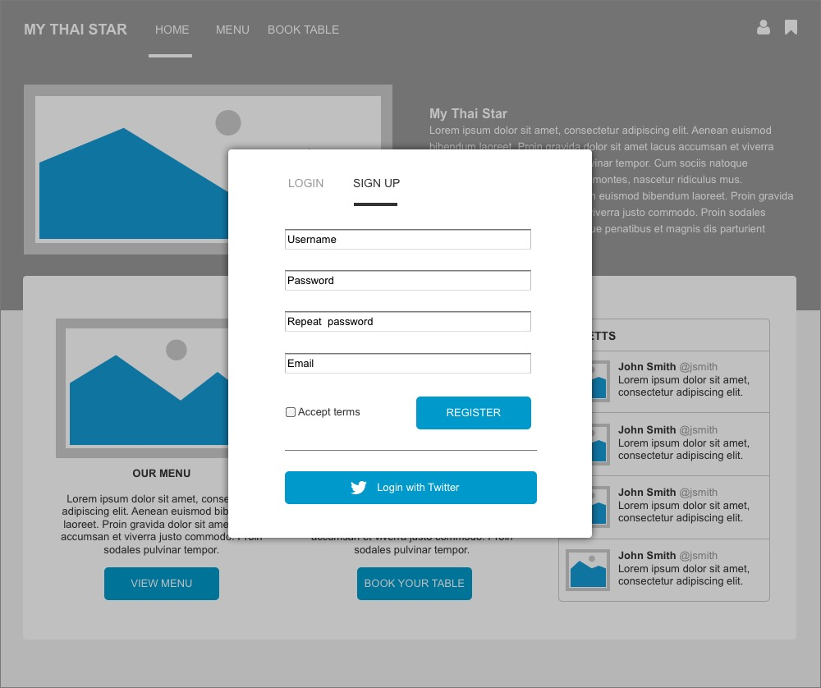
Sketches User Screens
Order Menu
Log In
Sign Up

Slide 44
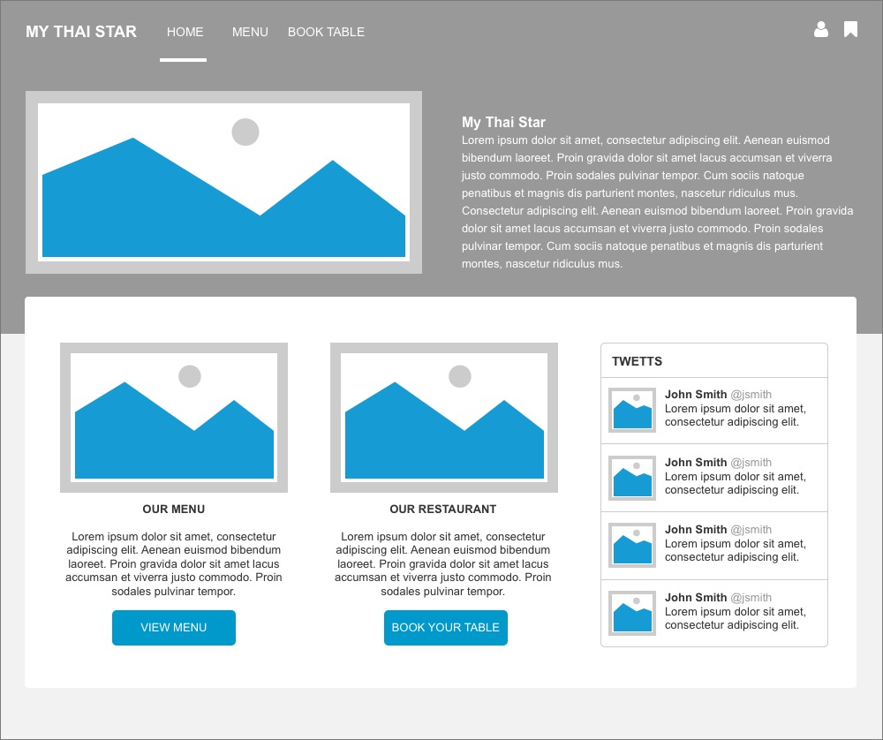
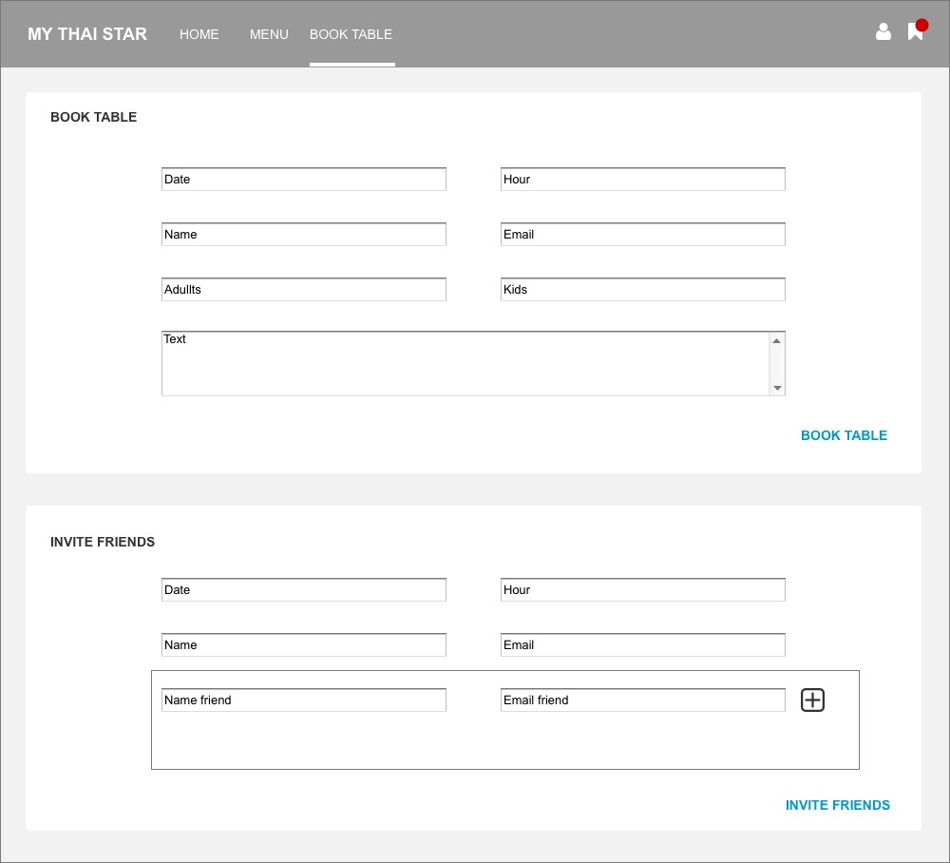
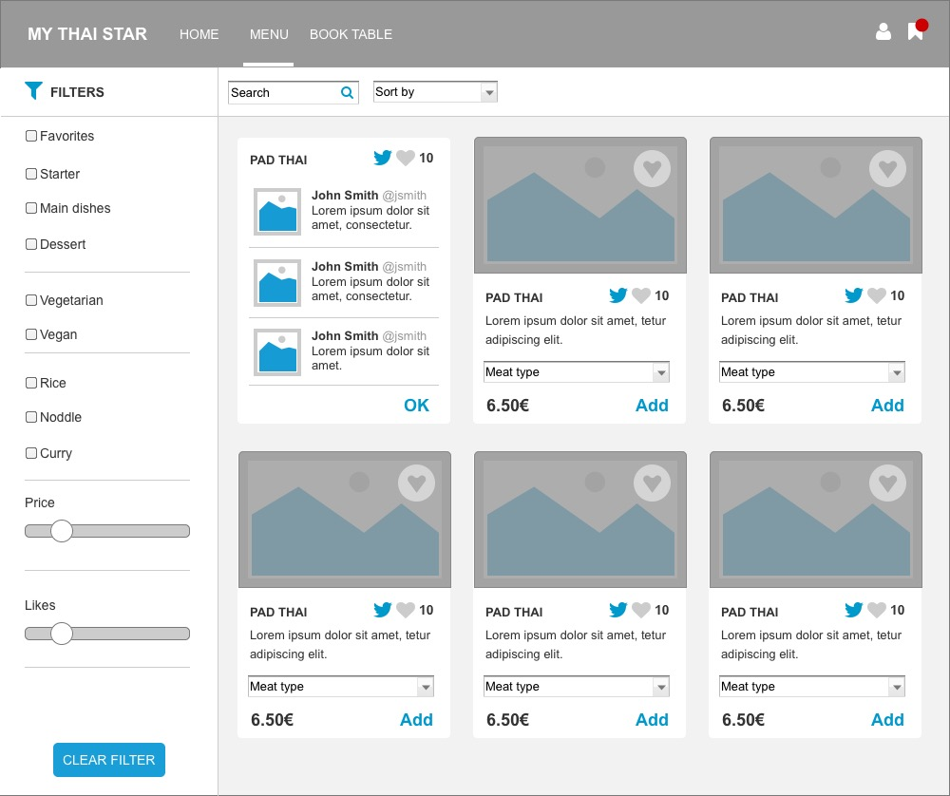
Sketches User Screens
Home Screen
Book a table/Invite Friends
View Menu

Slide 45
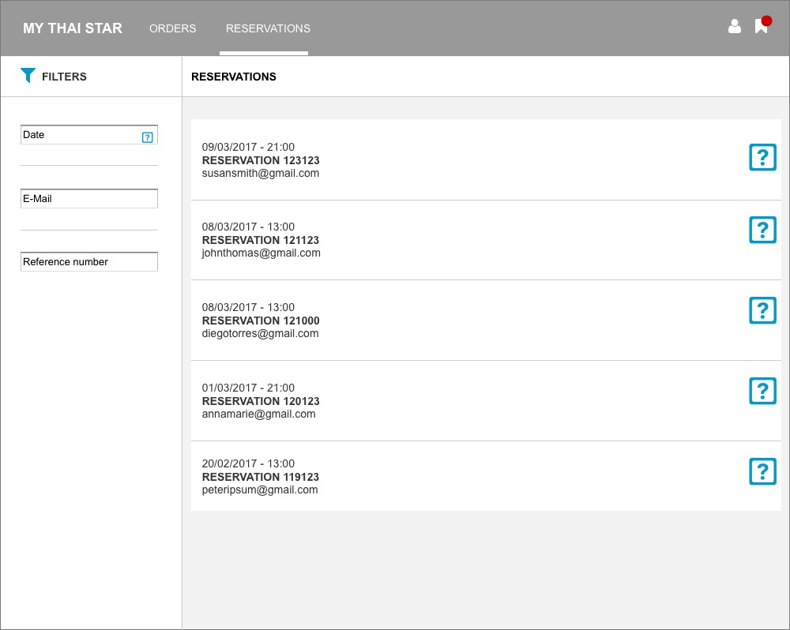
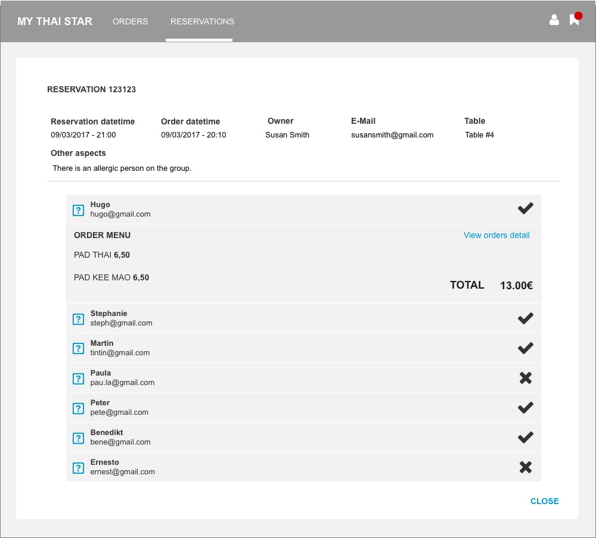
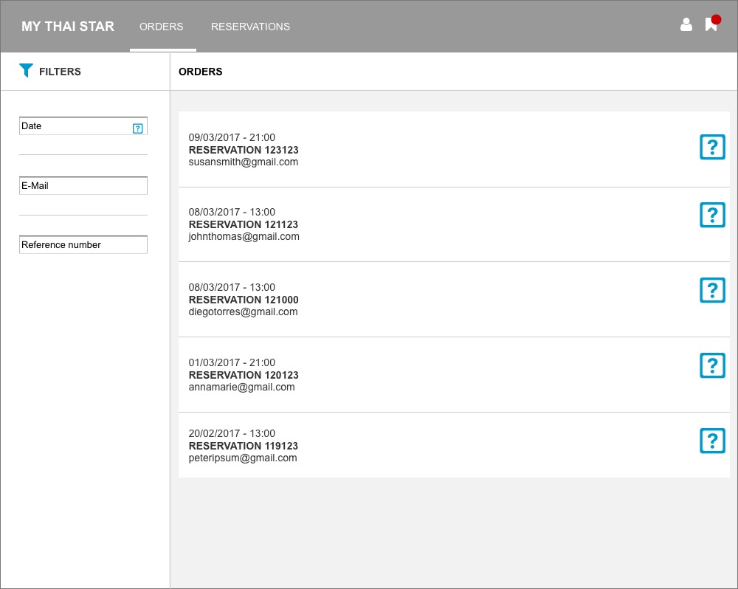
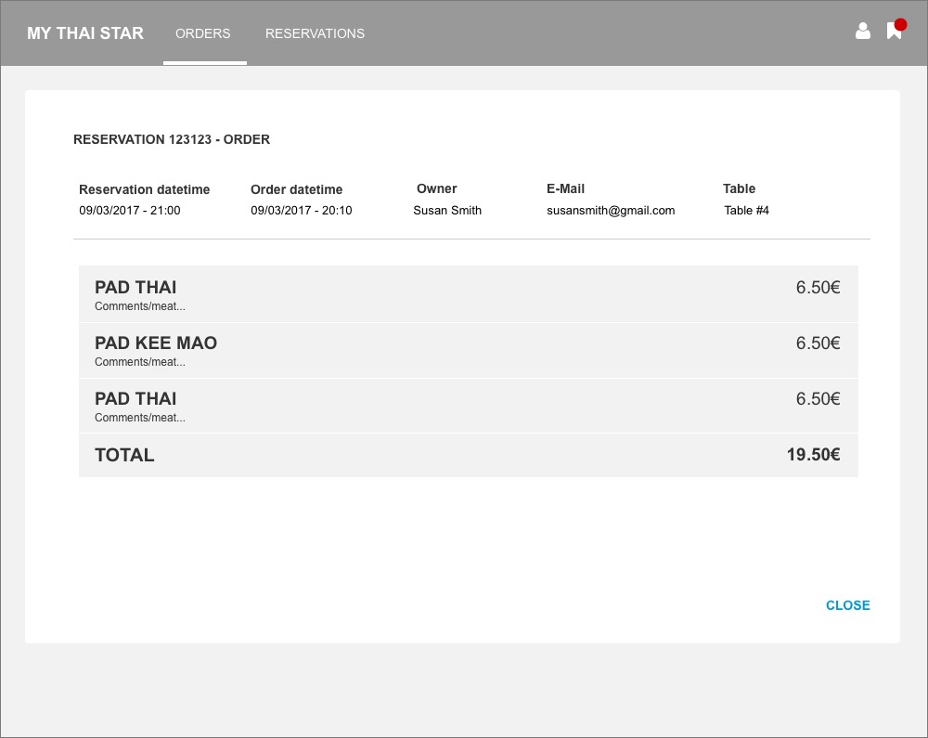
Sketches User Screens
Reservations
Reservation Detail
Orders
Order Detail

Slide 46
Conclusions
We will follow an Agile methodology for the development of the solution in order to reduce the time of each delivery and assure the business needs.
This document covers the necessary aspects that the system must fulfill.
In the following analysis phase, we will detail all solution aspects.

Slide 47
Thanks for your attention

